Slide 1


Slide 2

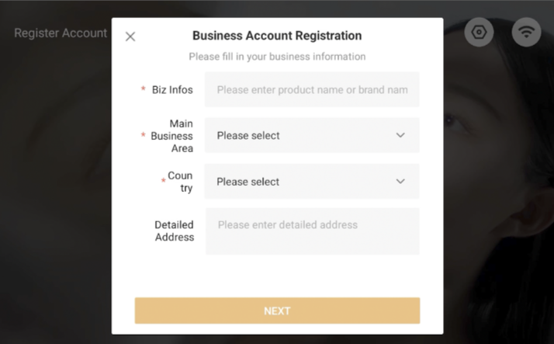
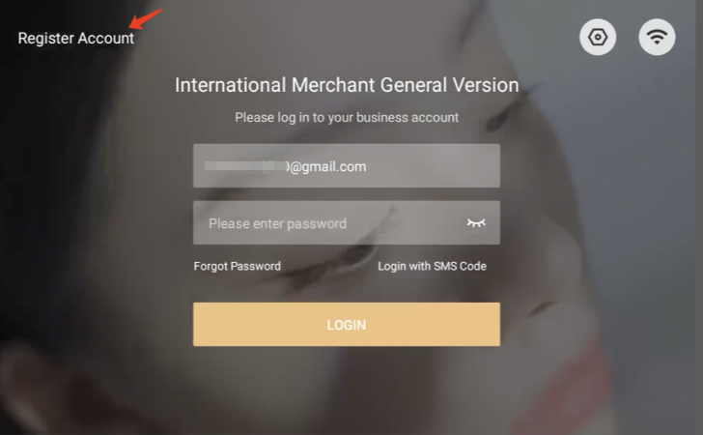
① Account Registration and Login
      Register an account
      Click on [ Register a new account ] on the login page and follow the pop-up prompt to complete the account registration in sequence.
      The steps include: Fill in account information > Email verification > Set password.

Slide 3
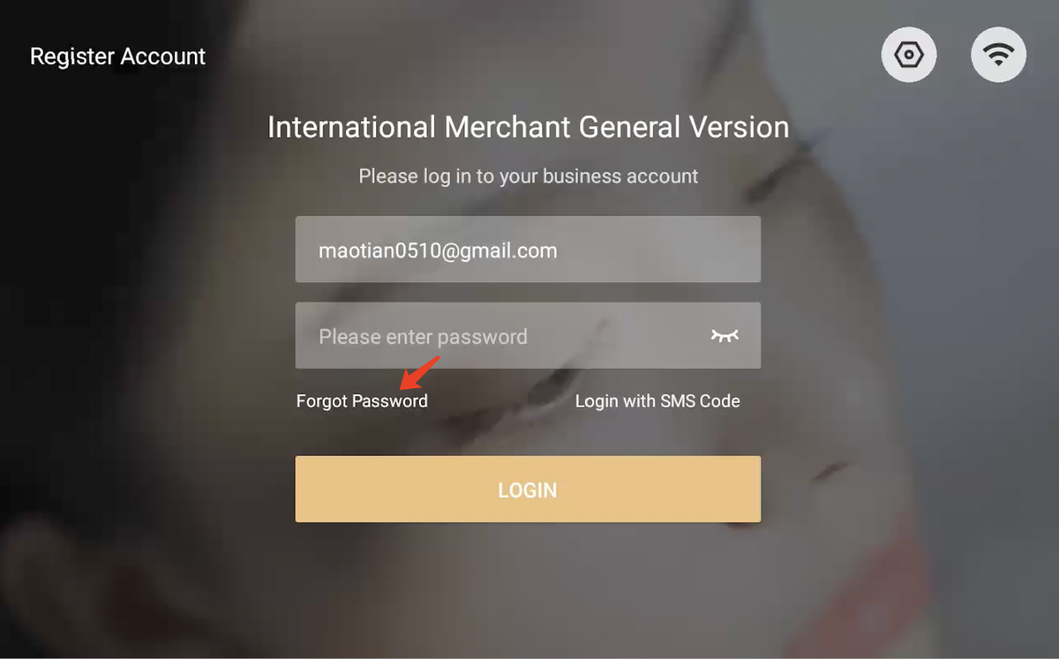
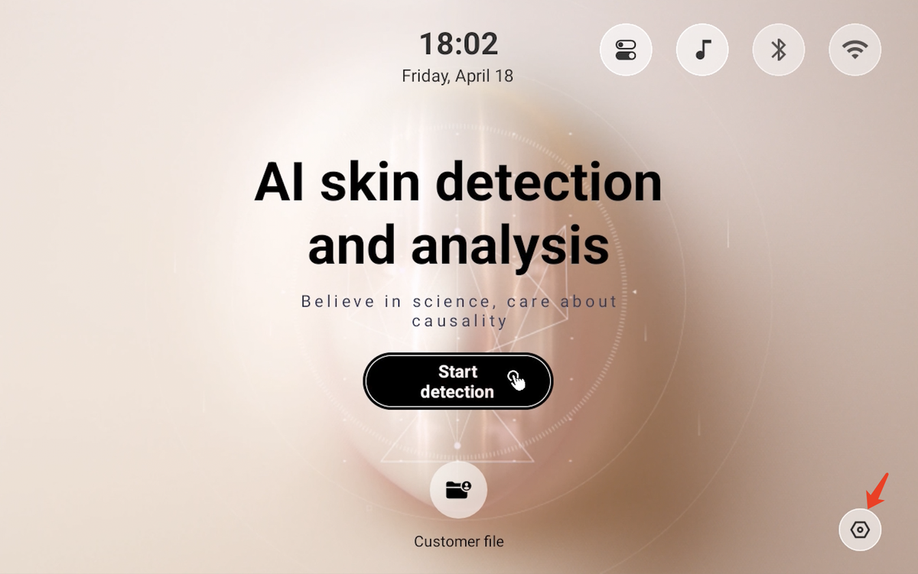
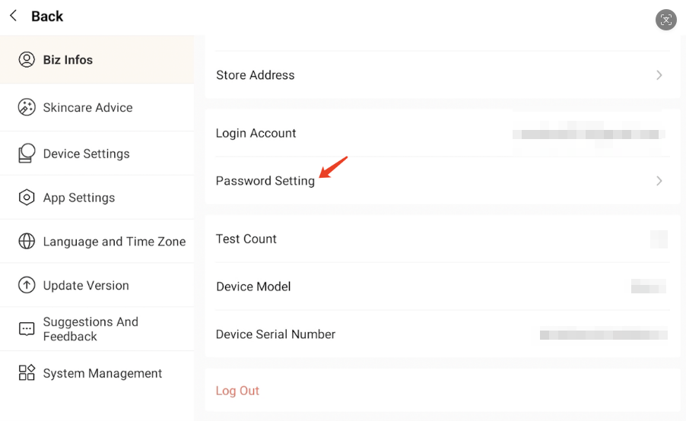
① Account Registration and Login
      Modify password
      (1) Forgot your password: On the login page, click [Forgot Password] and enter your email account to complete verification, then you can set a new password.
      (2) Modify password: Go to the home page, click the [Settings] entry,open "Merchant Information" and select "Password Settings" to modify password.

Slide 4
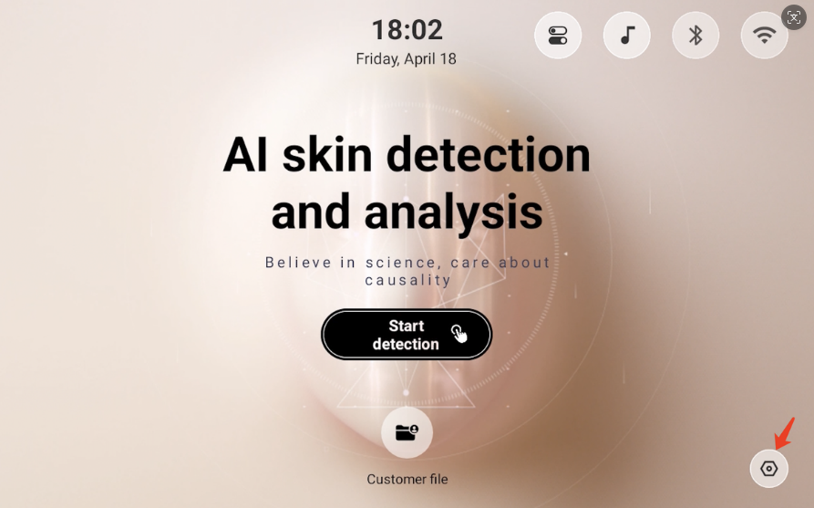
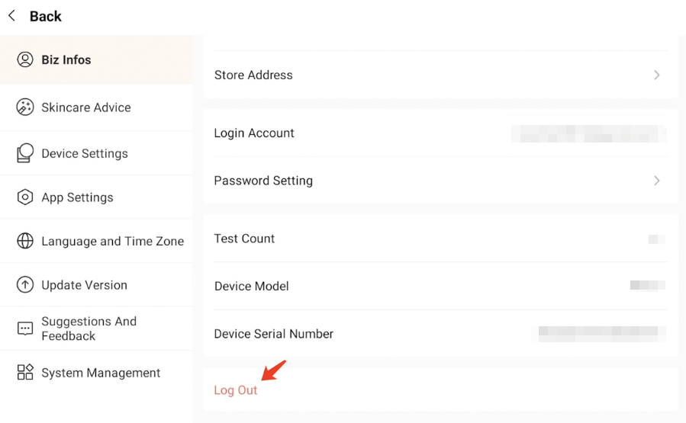
① Account Registration and Login
      Log out of account
      On the homepage, click the [ Settings ], go to the settings page, select "Biz Infos" and swipe to the bottom of the list and click [ Log Out ].

Slide 5
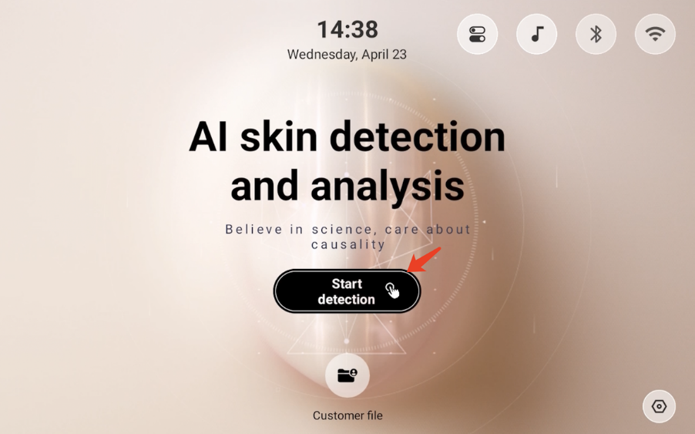
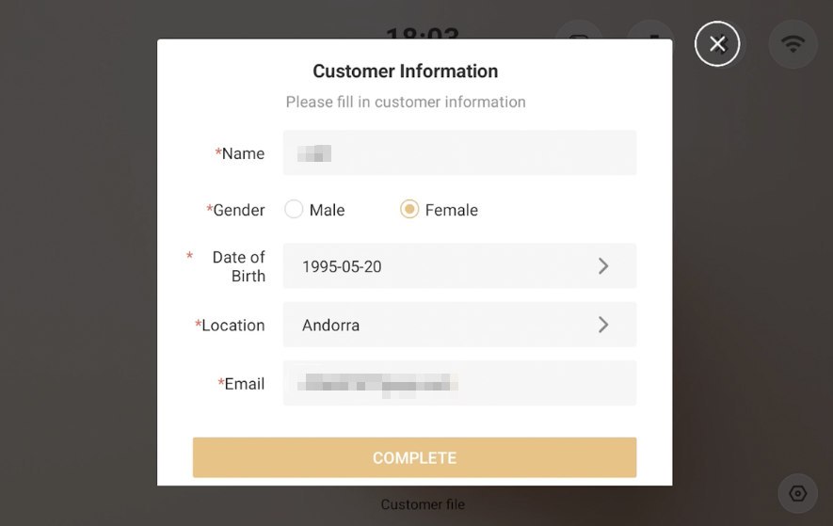
② Skin Imaging
      Add customer
      Click [Start detection] on the homepage, fill in the client information, then click [Complete]. The system will automatically create a client profile and redirect to the skin imaging page.

Slide 6
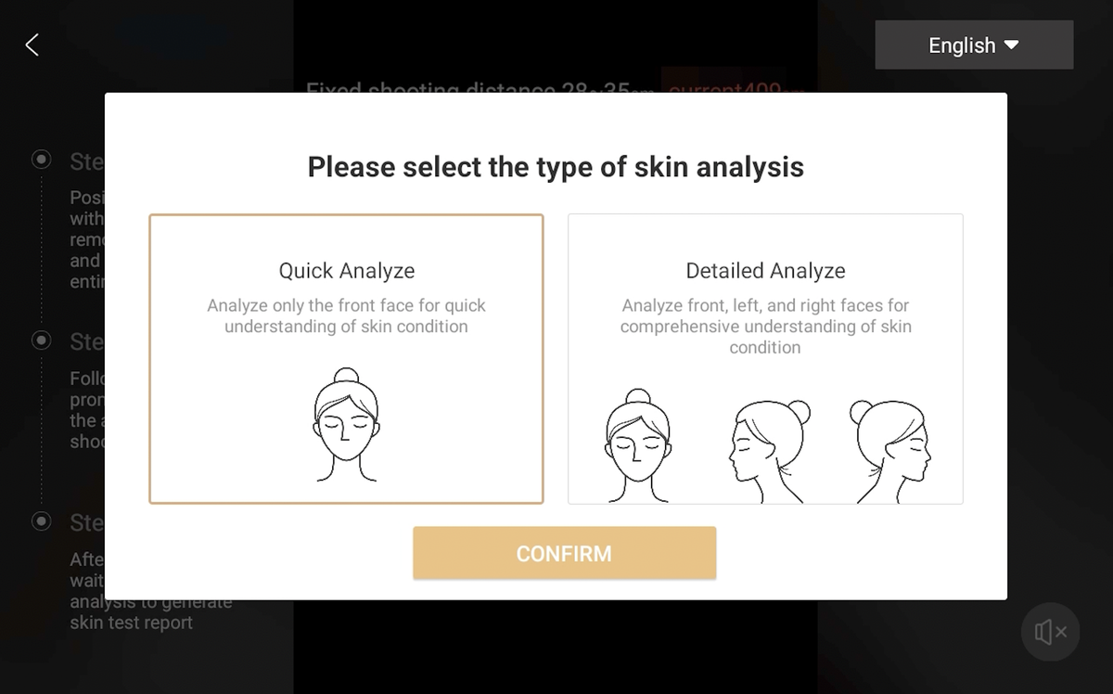
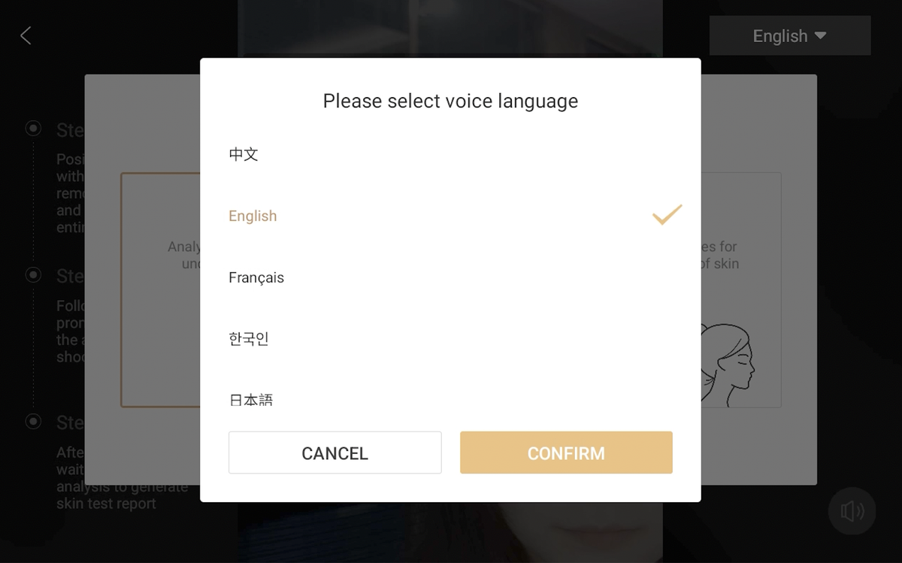
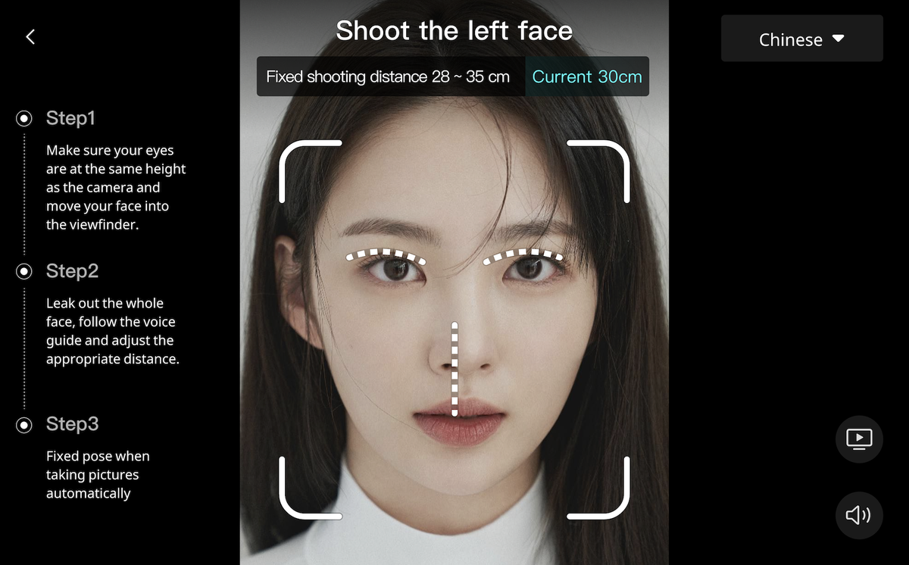
② Skin Imaging
      (1) After selecting the skin analysis type, please follow the voice prompt to prepare for the photo taking. The system will intelligently detect whether the distance and angle are suitable, and after confirming that they are correct, images will be automatically taken and analyzed by algorithms.
      (2) Switch voice prompt language: Click the language drop-down box in the upper right corner to select the corresponding language prompt.
      (3) After the skin analysis is finished, the page will immediately jump to the skin-testing report page, which presents you with detailed skin test results.

Slide 7
② Skin Imaging
      Instructions for taking skin photos:
      (1) Before taking skin photos, please remove your glasses and make sure you have no coverings on your face. Place the face smoothly within the frame so that the face remains parallel to the camera. Then, following the voice prompt, adjust your distance from the camera to between 28 cm and 32 cm.
      (2) During skin testing, the system will automatically take two photos in a row. Please maintain a fixed posture while taking photos.
      (1) Quick analysis: Only take front face photo. After the shooting is complete, the skin-test report
      will display images related to the face as well as data in various dimensions.
      (2) Detailed analysis: The system photographs front face, left face and right face in turn.
      Note about the type of skin test:

Slide 8
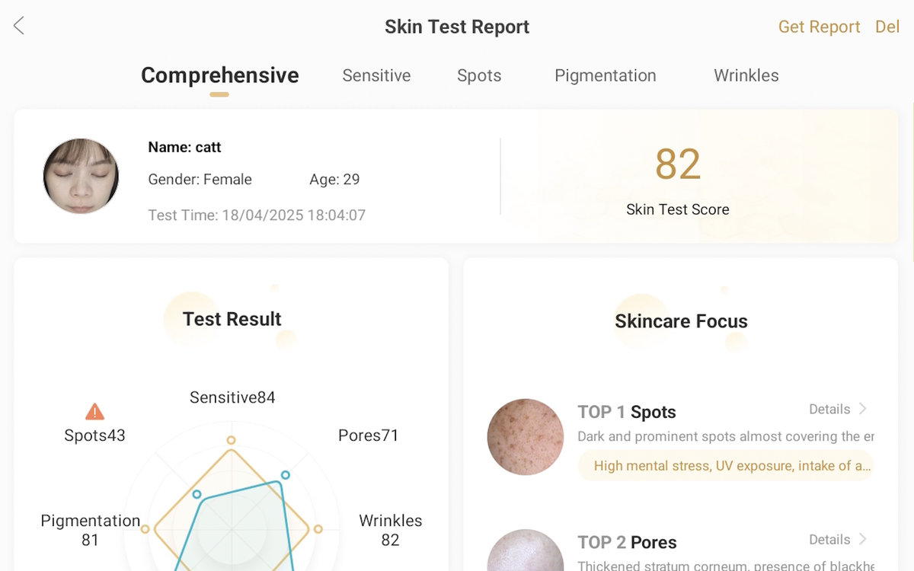
③ Skin Report
Open skin test report, swipe the page left and right or click on the dimensionname to see the corresponding dimension details page.

Slide 9
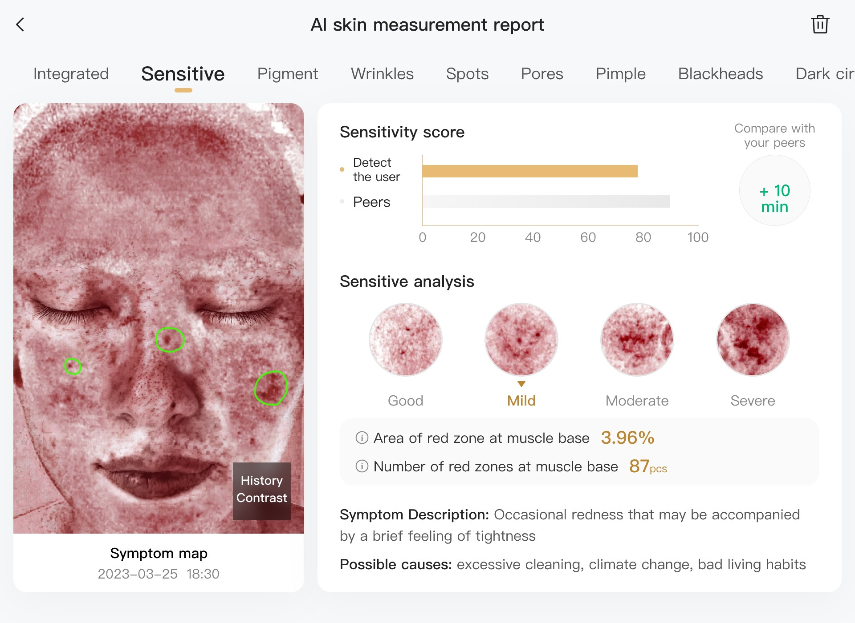
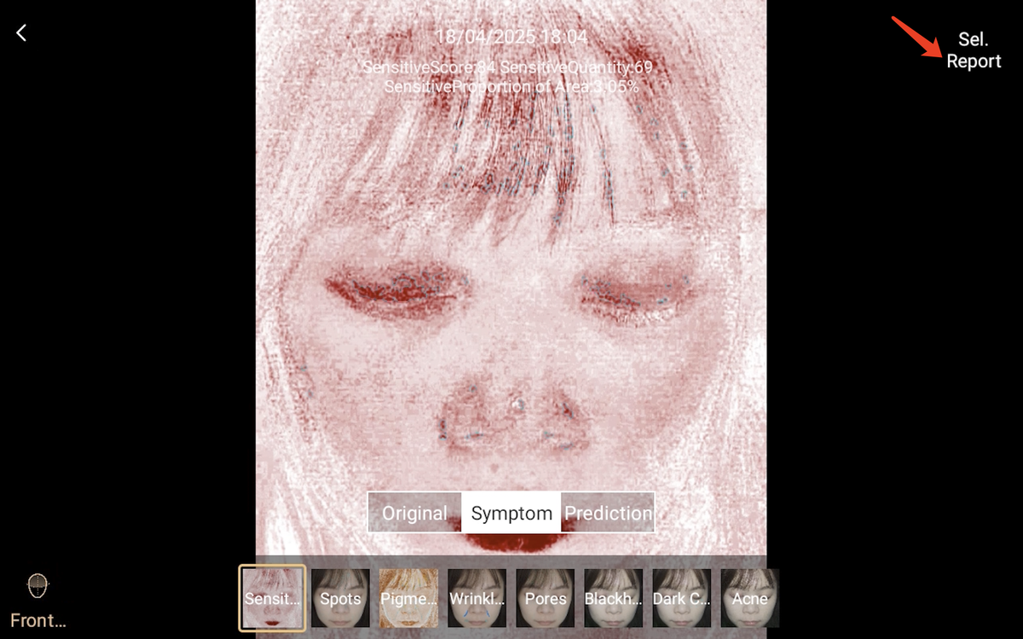
③ Skin Report
      Historical comparison
      (1) On the skin test report - symptom details page, click on the History Contrast to jump to the historical comparison page.
      (2) After entering the history comparison page, you can select and compare skin images of different periods.

Slide 10
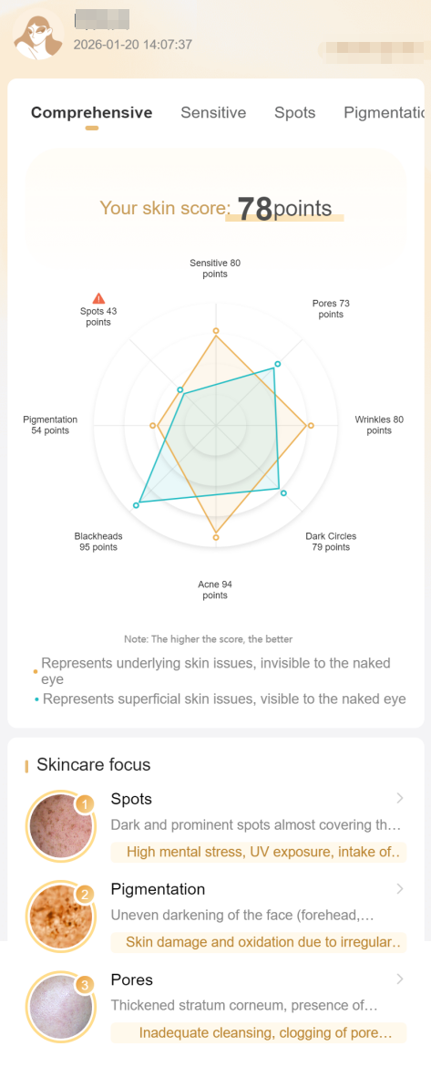
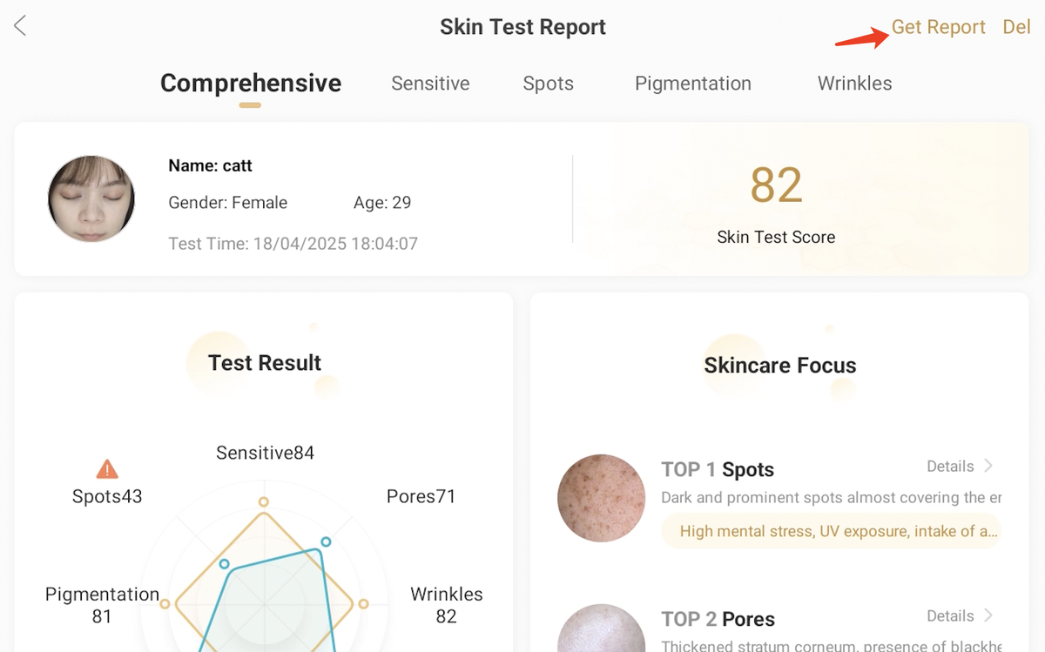
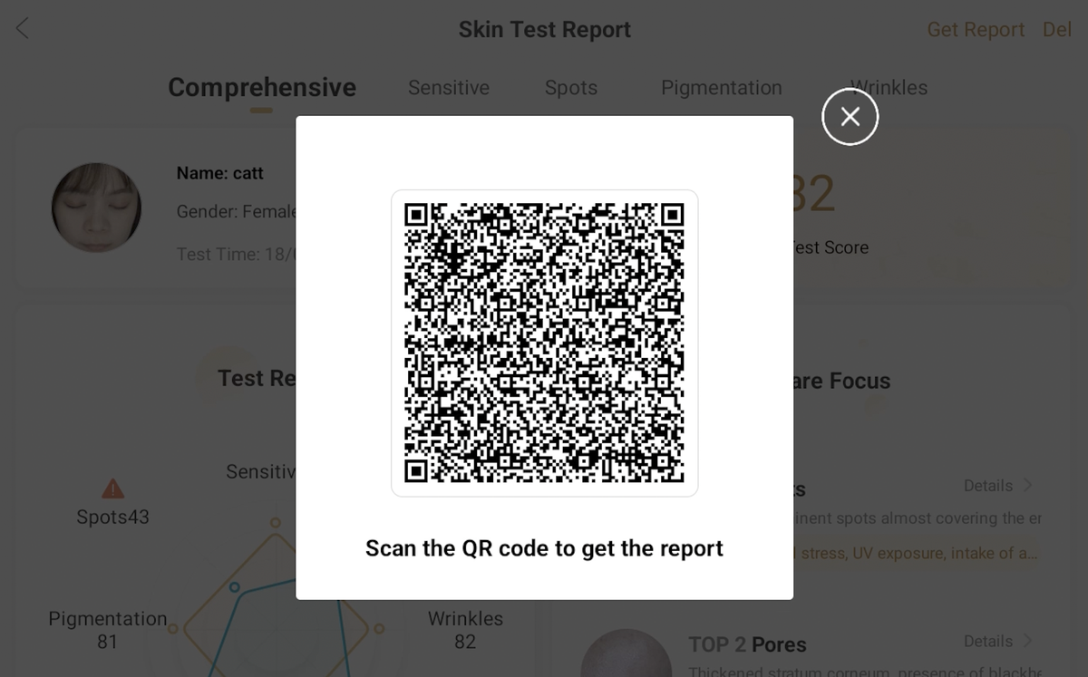
③ Skin Report
      Mobile report
Click on the upper right corner button [Get report], there’s a QR Code of mobile report. Clients can get a mobile report by scanning the QR Code. Note: Use the original camera, Google Browser, WeChat, etc.

Slide 11
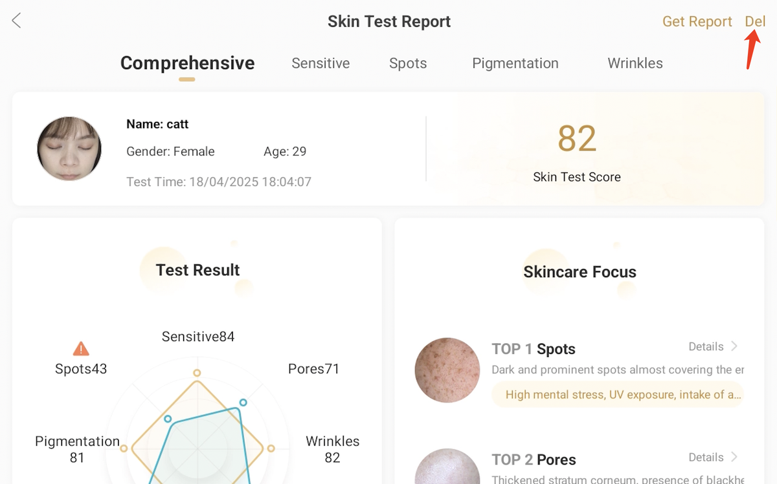
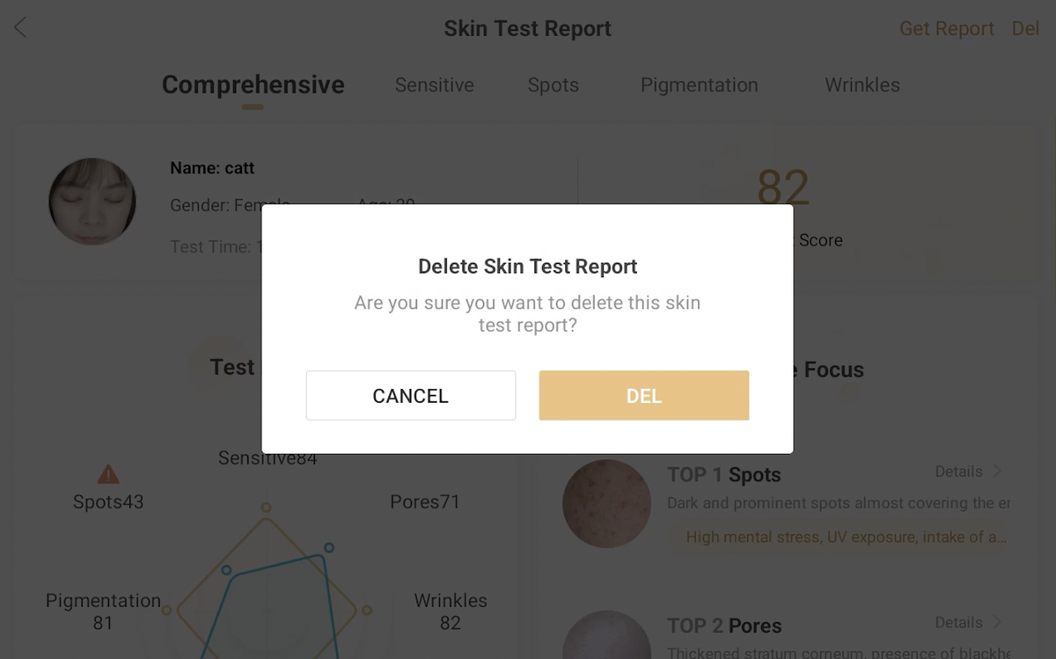
③ Skin Report
      Delete report
Click the top right corner button [Del] to delete report.

Slide 12
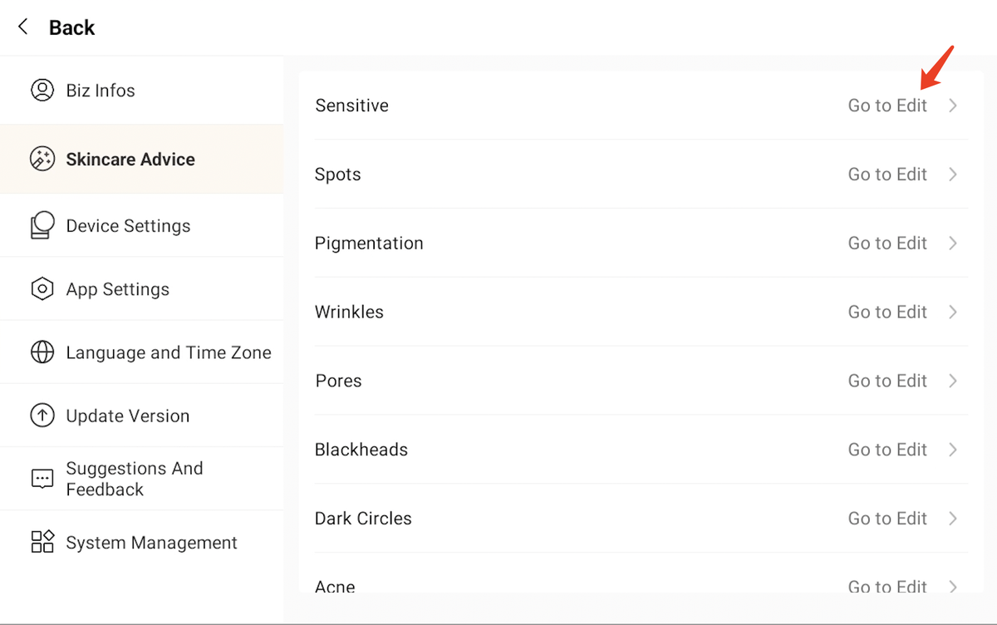
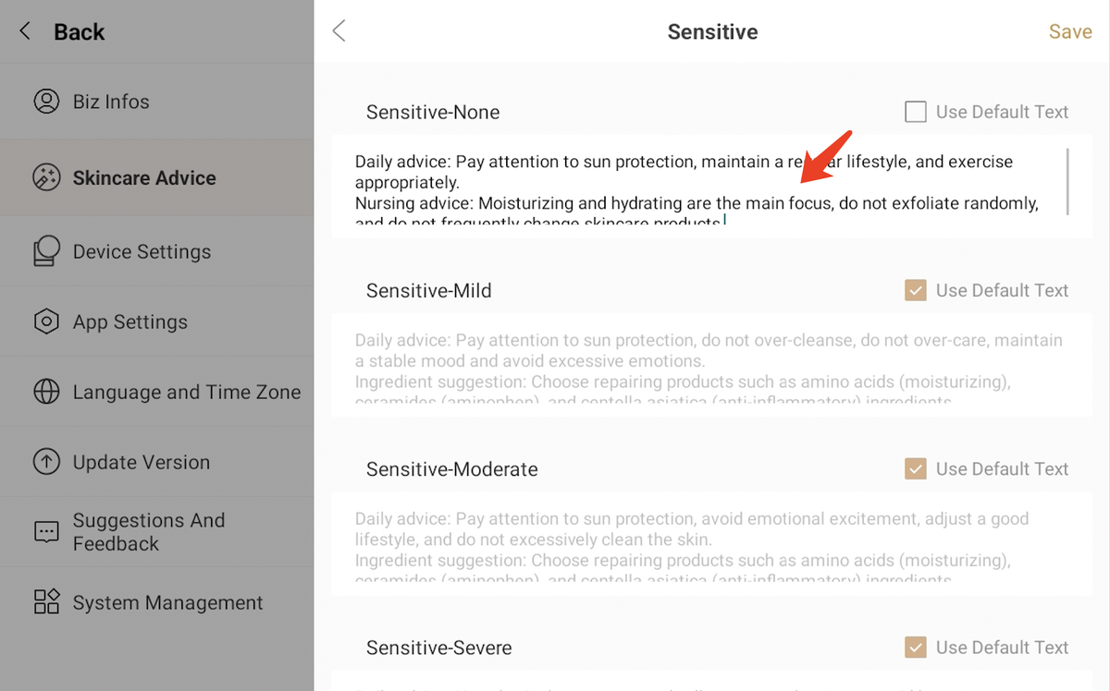
④ Custom Skin Report
      Customized skincare suggestion
(1) Click [Settings] button to enter the Settings page. Select second line "Skincare Advice" to modify the corresponding content shown within the skin test report.
(2) Select skin dimension that you want to edit, first uncheck [Use Default Copy], then fill in your own skincare suggestion. When finished editing, click [Save] to save this edit.
(3) Please note that if Use Default Text is checked, the system will apply the built-in text content.

Slide 13
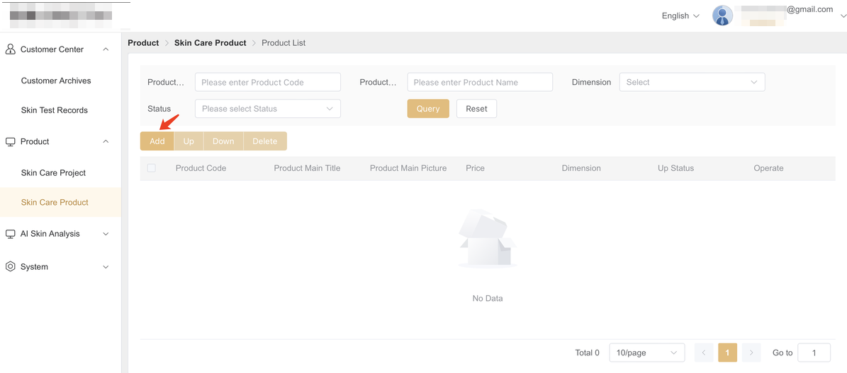
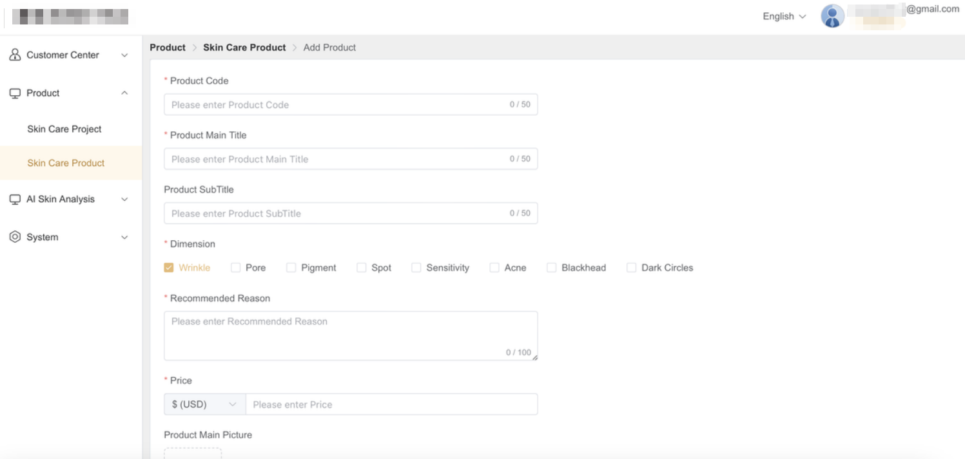
④ Custom Skin Report
      Customized skincare product
(1)This feature requires you to open the URL below in the web version of Google Browser：
https://www.simetras.com/
(2) Once logged in, click Product Management section and select Skin Care Project/ Skin Care Product.
(3) Fill in skincare project/ product details according to the page information and fill in project/ product information. After filling in all content, click the [Save] button.
Function Explanation:
Projects and products will be displayed according to the corresponding dimensions in the skin analysis report. The display weight priority is in the following order: price, number, and creation time.
Up to 9 projects and products are recommendable per dimension.

Slide 14

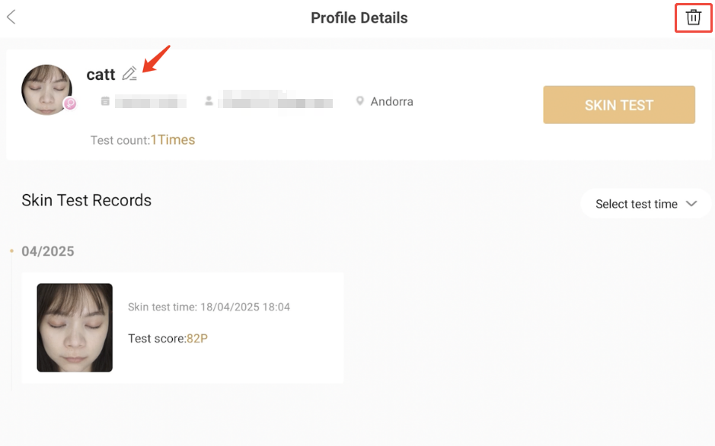
⑤ Customer Profile
View Customer Profile
On the home page, click [Customer Files] to enter the customer file list; you can also search for customer information by account name or email address.
Managing Customer Information
(1) Editing customer information: Click edit button to modify customer information.
(2) Deleting customer profile: Click the delete button in the top-right corner of the page to delete the customer profile and all associated skin test records in one click.

Slide 15

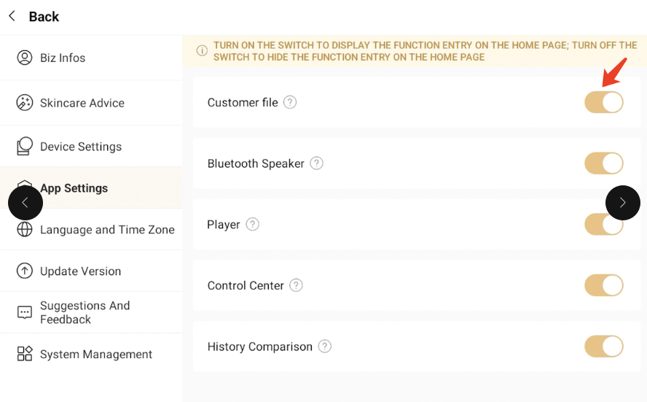
⑥ Settings
    App setting
On the home page, click settings button to enter the settings page, then select "App Settings". Toggle on the corresponding function switch to display the feature; toggle off the switch to hide the feature.

Slide 16
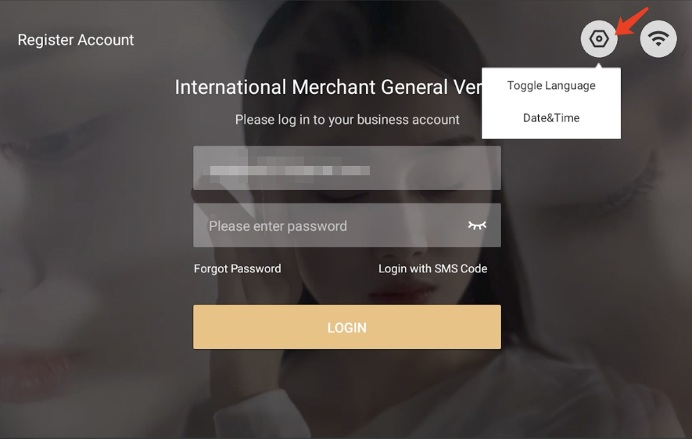

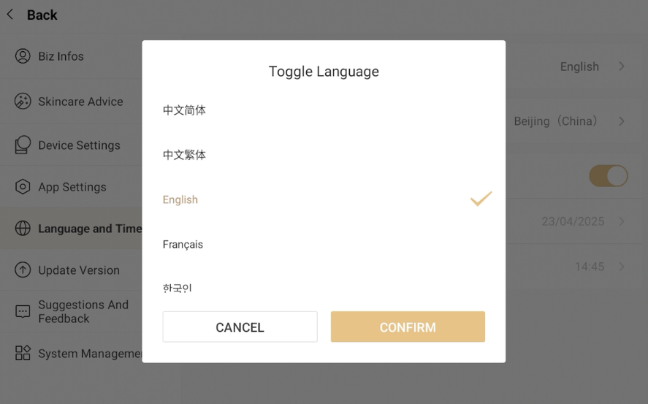
⑥ Settings
Language setting
(1) Method 1: On the login page, click switch language button in the upper-right corner and select the corresponding language and time.
(2) Method 2: On the home page, click the 【Settings】 entry to enter 【Language & Time】, then select the corresponding language and time.

Slide 17
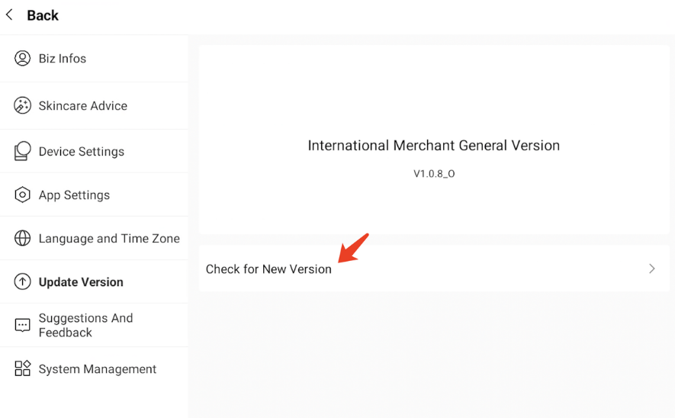
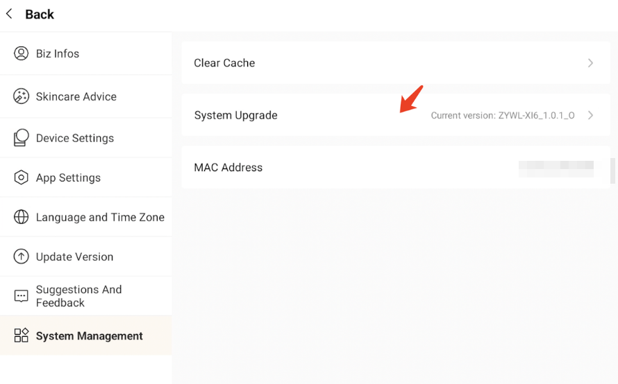
⑥ Settings
Upgrade
(1) APP upgrade:
On the home page, click Settings to enter the settings interface, then select "Update Version" > "Check for New Version", click 【 Check for New Version 】. Wait for the download to complete, then install the APP. The APP will exit during installation. Please restart it after the installation is successful.
(2) System upgrade:
On the home page, click Settings to enter the settings interface, then select "System Management", click 【 System Upgrade 】, click 【 System Upgrade 】. Wait for the download to complete, then install the system software. The device will shut down automatically during installation and restart automatically after the installation is successful.

Slide 18
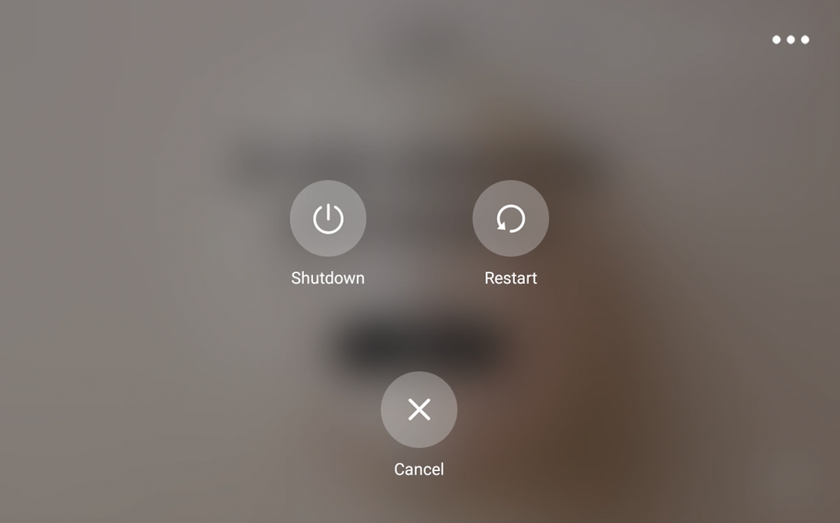
⑥ Settings
Power On/Off
(1) Power On: After powering on the device, short-press the power button (default setting: powers on automatically when connected to power).
(2) Power Off: Long-press the power button for 3 seconds to enter the power-off interface, then select 【Shutdown】.

Slide 19
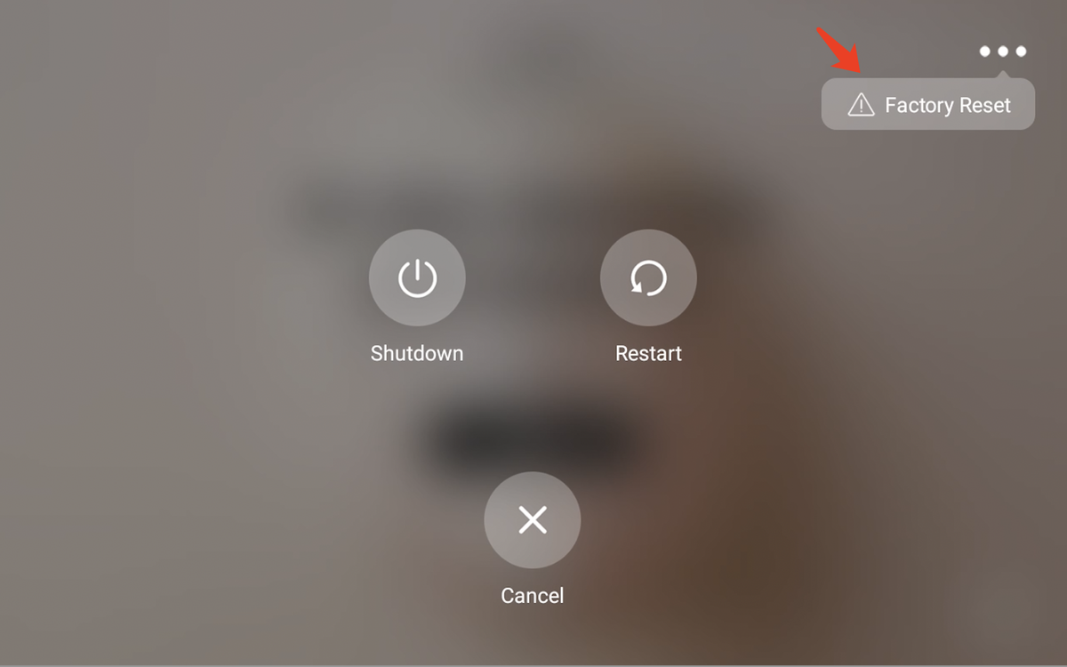
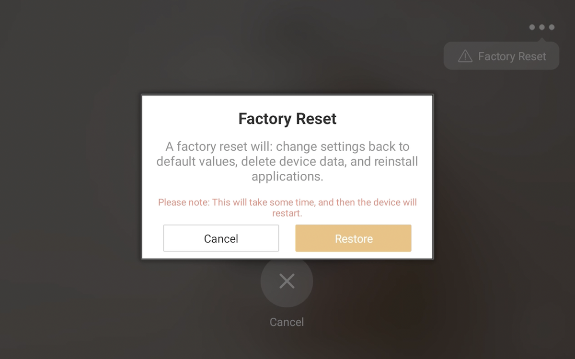
⑥ Settings
Factory Reset
(1) Long-press the power button for 3 seconds to enter the power-off interface.
(2) Tap the More icon in the upper-right corner, then select "Factory Reset".
(3) Follow the on-screen pop-up prompts and select 【 Restore 】.
Note: The system will shut down, and the device will restart automatically after initialization is complete.

Slide 20


